Slide 1
MODULE – II
Cloud Resource Management

Slide 2
INTRODUCTION
Resource management is a core function of any man-made system. It affects the three basic criteria for the evaluation of a system: performance, functionality, and cost.
An inefficient resource management has a direct negative effect on performance and cost and an indirect effect on the functionality of a system.
A cloud is a complex system with a very large number of shared resources subject to unpredictable requests and affected by external events it cannot control.
Cloud resource management requires complex policies and decisions for multi-objective optimization.
Cloud resource management is extremely challenging because of the complexity of the system, which makes it impossible to have accurate global state information, and because of the unpredictable interactions with the environment.

Slide 3
INTRODUCTION
The strategies for resource management associated with the three cloud delivery models, IaaS, PaaS, and SaaS, differ from one another.
In all cases the cloud service providers are faced with large, fluctuating loads that challenge the claim of cloud elasticity.
In some cases, when a spike can be predicted, the resources can be provisioned in advance,
e.g., for Web services subject to seasonal spikes.
For an unplanned spike, the situation is slightly more complicated.
Auto Scaling can be used for unplanned spike loads, provided that
(a) there is a pool of resources that can be released or allocated on demand and
(b) there is a monitoring system that allows a control loop to decide in real time to reallocate resources.
Auto Scaling is supported by PaaS services such as Google App Engine
Auto Scaling for IaaS is complicated due to the lack of standards

Slide 4
Policies and mechanisms for resource management
A policy typically refers to the principal guiding decisions, whereas mechanisms represent the means to implement policies
Cloud resource management policies can be loosely grouped into five classes:
1. Admission control. The explicit goal of an admission control policy is to prevent the system from accepting workloads in violation of high-level system policies; for example, a system may not accept an additional workload that would prevent it from completing work already in progress or contracted
2. Capacity allocation. Capacity allocation means to allocate resources for individual instances; an instance is an activation of a service.
3. Quality-of-service (QoS) guarantees. Quality of service is that aspect of resource management that is probably the most difficult to address and, at the same time, possibly the most critical to the future of cloud computing.

Slide 5
Policies and mechanisms for resource management
4. Load balancing and 5. Energy optimization. Load balancing and energy optimization are correlated and affect the cost of providing the services
  The common meaning of the term load balancing is that of evenly distributing the load to a set of servers. For example, consider the case of four identical servers, A, B,C, and D, whose relative loads are 80%, 60%, 40%, and 20%, respectively, of their capacity. As a result of perfect load balancing, all servers would end with the same load − 50% of each server’s capacity.
  In cloud computing a critical goal is minimizing the cost of providing the service and, in particular, minimizing the energy consumption
  This leads to a different meaning of the term load balancing; instead of having the load evenly distributed among all servers, we want to concentrate it and use the smallest number of servers while switching the others to standby mode, a state in which a server uses less energy
Many techniques are concentrated on system performance in terms of throughput and time in system, but they rarely include energy tradeoffs or QoS guarantees.
Some techniques are based on unrealistic assumptions; for example, capacity allocation is viewed as an optimization problem, but under the assumption that servers are protected from overload.

Slide 6
Policies and mechanisms for resource management
Allocation techniques in computer clouds must be based on a disciplined approach rather than ad hoc methods.
The four basic mechanisms for the implementation of resource management policies are:
  Control theory. Control theory uses the feedback to guarantee system stability and predict transient behavior, but can be used only to predict local rather than global behavior.
  Machine learning. A major advantage of machine learning techniques is that they do not need a performance model of the system. This technique could be applied to coordination of several autonomic system managers.
  Utility-based. Utility-based approaches require a performance model and a mechanism to correlate user-level performance with cost
  Market-oriented/economic mechanisms. Such mechanisms do not require a model of the system

Slide 7
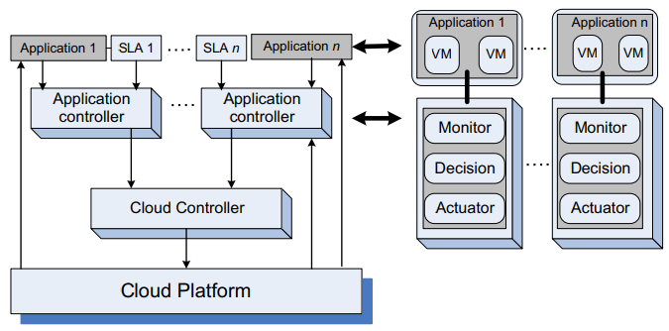
Stability of a two-level resource allocation architecture
In this section we discuss a two-level resource allocation architecture based on control theory concepts for the entire cloud.
The automatic resource management is based on two levels of controllers, one for the service provider and one for the application

Slide 8
Stability of a two-level resource allocation architecture
The main components of a control system are
  the inputs - The inputs in such models are the offered workload and the policies for admission control, the capacity allocation, the load balancing, the energy optimization, and the QoS guarantees in the cloud
  the control system components - The system components are sensors used to estimate relevant measures of performance and controllers that implement various policies
  the outputs - the output is the resource allocations to the individual applications
The controllers use the feedback provided by sensors to stabilize the system; stability is related to the change of the output. If the change is too large, the system may become unstable.
In our context the system could experience thrashing, the amount of useful time dedicated to the execution of applications becomes increasingly small and most of the system resources are occupied by management functions

Slide 9
Stability of a two-level resource allocation architecture
There are three main sources of instability in any control system:
1. The delay in getting the system reaction after a control action.
2. The granularity of the control, the fact that a small change enacted by the controllers leads to very large changes of the output.
3. Oscillations, which occur when the changes of the input are too large and the control is too weak, such that the changes of the input propagate directly to the output.
Two types of policies are used in autonomic systems: (i) threshold-based policies and (ii) sequential decision policies
If upper and lower thresholds are set, instability occurs when they are too close to one another if the variations of the workload are large enough and the time required to adapt does not allow the system to stabilize.
The actions consist of allocation/deallocation of one or more virtual machines; sometimes allocation/deallocation of a single VM required by one of the thresholds may cause crossing of the other threshold and this may represent, another source of instability

Slide 10
Scheduling algorithms for computing clouds
Scheduling is a critical component of cloud resource management. Scheduling is responsible for resource sharing/multiplexing at several levels.
A server can be shared among several virtual machines, each virtual machine could support several applications, and each application may consist of multiple threads.
The requirement to meet its design objectives, a scheduling algorithm should be efficient, fair, and starvation-free.
The objectives of a scheduler for a batch system are to maximize the throughput (the number of jobs completed in one unit of time, e.g., in one hour) and to minimize the turnaround time (the time between job submission and its completion).
For a real-time system the objectives are to meet the deadlines and to be predictable
Some schedulers are preemptive, allowing a high-priority task to interrupt the execution of a lower-priority one; others are nonpreemptive.
Two distinct dimensions of resource management must be addressed by a scheduling policy:
  the amount or quantity of resources allocated and
  the timing when access to resources is granted

Slide 11
Scheduling algorithms - Fair queuing
Fair queuing is a scheduling algorithm used in cloud computing and networking to allocate resources fairly among multiple users or applications.
The goal is to ensure that each user or application receives a fair share of the available resources, preventing one user or application from dominating the system and causing unfair delays for others.
Here are the key concepts and characteristics of fair queuing
Queues for Resource Requests:
  Each user or application is assigned a separate queue for their resource requests.
  Queues can be based on various factors, such as priority, weight, or resource requirements.
Scheduling Mechanism:
  The scheduler assigns time slices or resources to each queue in a fair and equitable manner.
  The allocation can be based on the weighted fair queuing (WFQ) approach, where each queue is assigned a weight, and resources are distributed in proportion to these weights.
Weighted Fair Queuing (WFQ):
  WFQ ensures that users or applications with higher weights receive a larger share of resources.
  It is particularly useful when different users have different priorities or varying resource requirements.

Slide 12
Scheduling algorithms - Fair queuing
Packet or Task Scheduling:
  Fair queuing can be applied at the packet level for network traffic or at the task level for computational resources.
  In a cloud computing environment, tasks or jobs submitted by users are scheduled fairly based on their assigned queues.
Enforcement of Fairness:
  The scheduling algorithm enforces fairness by dynamically adjusting resource allocations based on the current demand and weights assigned to different queues.
  Feedback mechanisms may be used to collect information about the actual resource consumption of each queue.
Preventing Starvation:
  Fair queuing aims to prevent starvation, ensuring that every user or application gets a reasonable share of resources over time.
  Time-based or round-robin approaches may be used to cycle through queues and prevent any single user from being consistently favored.
Adaptability:
  Fair queuing algorithms should be adaptable to changing workloads and dynamically adjust resource allocations based on demand.
Implementation Challenges:
  Implementing fair queuing in a distributed and scalable cloud environment can be challenging.
  Efficient data structures and algorithms are required to handle a large number of queues and dynamic resource allocation.

Slide 13

Scheduling algorithms - Fair queuing
Example: three users: User X, User Y, and User Z, each with different weights representing their relative priority or resource requirements.
Assume the following weights for each user:
User X:
  Weight = 3
User Y:
  Weight = 2
User Z:
  Weight = 1
Now, let's simulate the fair queuing scheduling process:
Queue Initialization:
  Each user has a separate queue, and the scheduler initializes the queues.

Slide 14

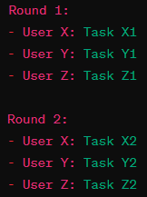
Scheduling algorithms - Fair queuing
Resource Allocation:
  The scheduler allocates resources to each user based on their weights. For simplicity, let's consider CPU time.
Queue Processing:
  Users submit tasks or jobs to their respective queues for CPU processing.
  The scheduler processes tasks in a round-robin fashion, giving each user a fair share of CPU time based on their weights.

Slide 15
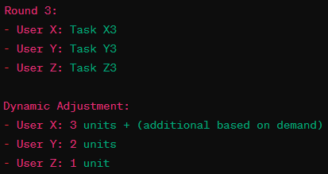

Scheduling algorithms - Fair queuing
Dynamic Adjustments:
  If User X submits more tasks, the scheduler dynamically adjusts the resource allocations.
Preventing Starvation:
  Fair queuing ensures that even if a user has a higher weight, others are not starved.
  For example, User Z will still get its fair share of resources in each round.

Slide 16
Scheduling algorithms - start time fair queuing
The "start time fair queuing" (STFQ) scheduling algorithm is a variant of fair queuing designed to address the issue of head-of-line blocking in traditional fair queuing algorithms.
Head-of-line (HoL) blocking occurs if there is a single queue of data packets waiting to be transmitted, and the packet at the head of the queue (line) cannot move forward due to congestion, even if other packets behind this one could
In STFQ, each packet or task is associated with a start time, and the scheduler ensures that the packets are transmitted or processed in the order of their start times.
This approach aims to minimize the delay for each flow by allowing newer flows to progress ahead of older ones.
Here's a brief explanation of the STFQ scheduling algorithm:
Start Time Assignment:
  Each incoming packet or task is assigned a start time based on when it enters the system or queue.
Queue Processing:
  The scheduler processes the queues based on the start times assigned to the packets or tasks.

Slide 17
Scheduling algorithms - start time fair queuing
Transmission or Execution:
  Packets or tasks are transmitted or executed in the order of their start times.
  Newer flows with later start times are given precedence over older flows, reducing head-of-line blocking.
Fairness and Delay Minimization:
  STFQ aims to provide fairness among different flows while minimizing the delay for individual flows.
Dynamic Adjustments:
  The algorithm dynamically adjusts the start times based on the arrival of new packets or tasks.
  Older flows that have been delayed due to head-of-line blocking are allowed to progress as newer flows arrive.
Preventing Starvation:
  STFQ helps prevent starvation by ensuring that older flows eventually get their turn, even if newer flows are continually arriving.

Slide 18
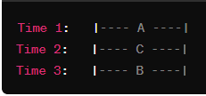
Scheduling algorithms - start time fair queuing
Example:
Consider a scenario with three flows (A, B, and C) entering the system with start times assigned as follows:
  Flow A: Start time = 1
  Flow B: Start time = 3
  Flow C: Start time = 2
The scheduler processes the flows in the order of their start times: A (1), C (2), B (3).
In this example, Flow A, with a start time of 1, is processed first, followed by Flow C (start time 2), and then Flow B (start time 3).
This order minimizes the delay for each flow, and the scheduler dynamically adjusts based on the arrival times of new flows.

Slide 19

Scheduling algorithms - start time fair queuing
If a new flow (e.g., Flow D) with a start time of 1.5 arrives, the scheduler dynamically adjusts the processing order:
Now, Flow D, which arrived later than Flow A but earlier than Flow C and Flow B, gets its turn before the other flows.
Fairness and Delay Minimization:
  The STFQ algorithm continues to process flows based on their start times, dynamically adjusting to new arrivals and minimizing delays for each flow.
The STFQ scheduling algorithm in cloud computing helps overcome head-of-line blocking issues by prioritizing newer flows based on their start times.

Slide 20
Scheduling algorithms - borrowed virtual time (BVT)
The Borrowed Virtual Time (BVT) algorithm is indeed a scheduling algorithm designed to support low-latency dispatching of real-time applications while also facilitating a weighted sharing of the CPU among different classes of applications.
The BVT algorithm was proposed to address the scheduling needs of both real-time and non-real-time tasks within the same system.
Here are key features and objectives of the BVT algorithm:
Low-Latency Dispatching for Real-Time Applications:
  BVT aims to minimize the response time for real-time tasks by considering their urgency and allowing them to be scheduled quickly.
Weighted CPU Sharing:
  BVT supports the concept of weighted CPU sharing among different classes of applications or tasks.
  Each class is assigned a weight, and the scheduler allocates CPU time to classes proportionally based on their weights.

Slide 21
Scheduling algorithms - borrowed virtual time (BVT)
Borrowed Virtual Time Concept:
  BVT introduces the notion of "borrowed virtual time" to prioritize real-time tasks.
  Real-time tasks can borrow virtual time from the future to be scheduled more quickly, providing low-latency dispatching.
Dynamic Adjustment of Priorities:
  BVT dynamically adjusts priorities based on the urgency of tasks, allowing real-time tasks to receive higher priority when needed.
Fairness and Predictability:
  While providing low-latency for real-time tasks, BVT also strives to maintain fairness and predictability for non-real-time tasks.
Adaptability to Varying Workloads:
  The algorithm is designed to adapt to varying workloads, ensuring that real-time tasks get the necessary resources without completely starving non-real-time tasks.
Integration with Linux Scheduler:
  BVT has been implemented as a scheduling policy in the Linux kernel to support mixed workloads, combining real-time and non-real-time tasks.

Slide 22
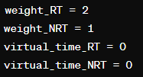
Scheduling algorithms - borrowed virtual time (BVT)
Example: Assume we have two classes of tasks: real-time tasks (Class RT) and non-real-time tasks (Class NRT).
Initialization:
  Each class is assigned a weight, denoted by weight_RT for real-time tasks and weight_NRT for non-real-time tasks.
  Virtual time counters, virtual_time_RT and virtual_time_NRT, are initialized for each class.
Scheduling:
  Tasks of both classes are submitted to the scheduler.
  The scheduler uses the BVT algorithm to determine the scheduling order based on the borrowed virtual time.

Slide 23



Scheduling algorithms - borrowed virtual time (BVT)
Task Execution:
  For simplicity, let's assume each task takes one time unit to execute.
  RT1 and NRT1 are real-time and non-real-time tasks of the first time unit, respectively.
  RT2 and NRT2 are tasks of the second time unit.
Updating Borrowed Virtual Time:
  After each time unit, update the virtual time counters for each class based on the weights.
  For example, if weight_RT = 2 and weight_NRT = 1, after the first time unit:

Slide 24

Scheduling algorithms - borrowed virtual time (BVT)
Dynamic Adjustments:
  Real-time tasks can borrow virtual time from the future to achieve low-latency dispatching.
  If a real-time task arrives and needs higher priority, it may borrow virtual time.
  RT3 arrives and borrows virtual time to be scheduled earlier.
Adaptability to Varying Workloads:
  The algorithm dynamically adjusts to varying workloads by updating virtual time counters based on weights, allowing real-time tasks to receive higher priority when needed.

Slide 25
Cloud scheduling subject to deadlines
In cloud computing, scheduling subject to deadlines is crucial, especially when dealing with real-time or time-sensitive applications.
The scheduling algorithms in this context aim to meet task deadlines and ensure efficient resource utilization.
Here are a few concepts and algorithms related to cloud scheduling with deadlines:
Real-Time Scheduling:
  Real-time scheduling involves the execution of tasks within specified deadlines.
  Hard real-time tasks have strict deadlines, and missing a deadline can result in system failure.
  Soft real-time tasks have deadlines, but occasional misses may be tolerable.
Earliest Deadline First (EDF):
  EDF is a dynamic priority scheduling algorithm where the task with the earliest deadline is scheduled first.
  This algorithm ensures that tasks with imminent deadlines are prioritized.

Slide 26
Cloud scheduling subject to deadlines
Rate-Monotonic Scheduling (RMS):
  RMS assigns priorities based on task periods, with shorter periods receiving higher priority.
  Tasks with shorter execution times have higher priority in this preemptive scheduling algorithm.
Deadline Monotonic Scheduling (DMS):
  DMS assigns priorities based on task deadlines, with tasks having earlier deadlines receiving higher priority.
  Similar to RMS, it is a preemptive scheduling algorithm.
Task Admission Control:
  Before accepting tasks, the cloud scheduler may perform admission control to ensure that new tasks can meet their deadlines.
  This involves analyzing the current system state and estimating whether the requested resources are available within the given timeframe.
  Scheduling in a cloud environment subject to deadlines requires a balance between meeting real-time requirements and efficiently utilizing resources. The choice of scheduling algorithm depends on the specific characteristics and priorities of the tasks and applications running in the cloud system.

Slide 27
Scheduling MapReduce applications subject to deadlines
Scheduling MapReduce applications subject to deadlines involves efficiently allocating resources and managing the execution of tasks within specified time constraints.
MapReduce is a programming model commonly used for processing and generating large-scale data sets in parallel.
Here are some considerations and strategies for scheduling MapReduce applications with deadlines:
Task Decomposition:
  Break down MapReduce jobs into smaller tasks, such as map tasks and reduce tasks.
  Each task should have well-defined input and output, allowing for parallel execution.
Task Prioritization:
  Assign priorities to MapReduce tasks based on their deadlines and importance.
  High-priority tasks should be scheduled and executed first to meet deadlines.

Slide 28
Scheduling MapReduce applications subject to deadlines
Deadline-Aware Scheduling Algorithms:
  Utilize scheduling algorithms that are aware of deadlines, such as Earliest Deadline First (EDF) or other real-time scheduling strategies.
  EDF ensures that tasks with earlier deadlines are scheduled first, minimizing the chances of missing deadlines.
Resource Reservation:
  Reserve resources for MapReduce jobs to ensure they have the necessary computational power and storage to meet deadlines.
  Perform admission control to assess whether the requested resources are available within the specified timeframe.
Data Locality:
  Schedule tasks on nodes where the required input data is already present to minimize data transfer overhead.
  Data locality optimizations can improve task execution times and enhance the chances of meeting deadlines.

Slide 29
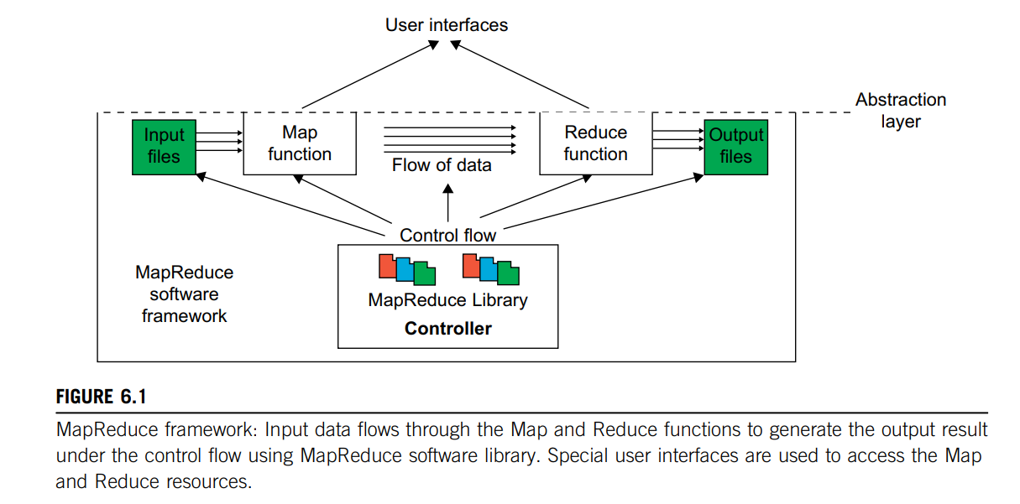
MAP REDUCE
  MapReduce,, is a software framework which supports parallel and
  distributed computing on large data sets .
  This software framework abstracts the data flow of running a parallel program on a distributed computing system by providing users with two interfaces in the form of two functions:
  Map and Reduce. Users can override these two functions to interact with and manipulate the data flow of running their programs. Figure 6.1 illustrates the logical data flow from the Map to the Reduce function in MapReduce frameworks.

Slide 30
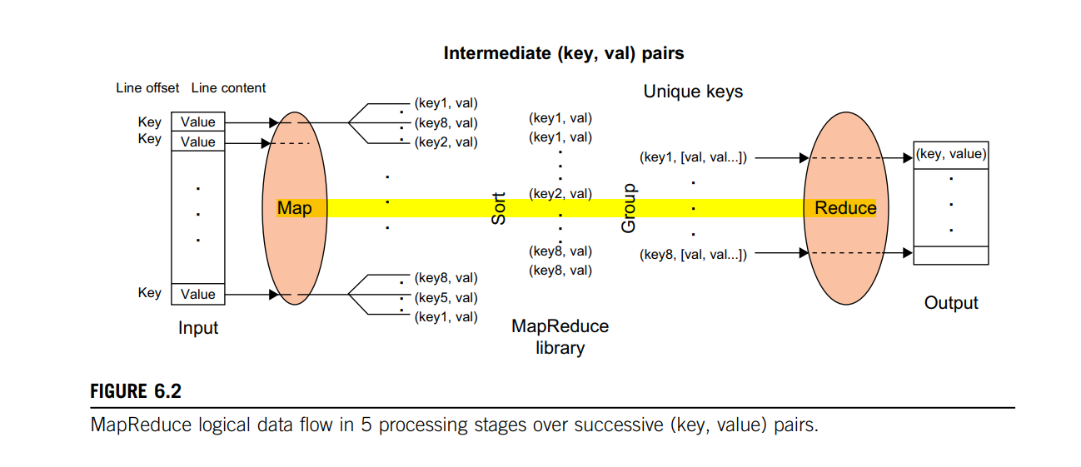
MAP REDUCE

Slide 31
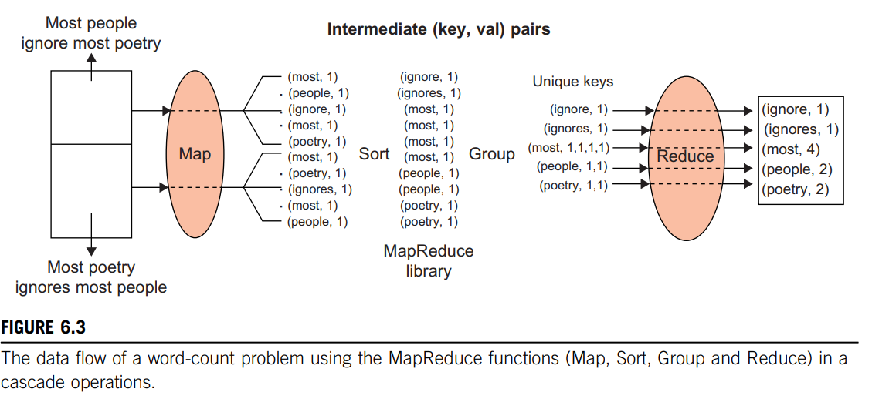

Slide 32
Resource management and dynamic application scaling
The demand for computing resources, such as CPU cycles, primary and secondary storage, and network bandwidth, depends heavily on the volume of data processed by an application.
The demand for resources can be a function of the time of day, can monotonically increase or decrease in time, or can experience predictable or unpredictable peaks.
Example: A service for income tax processing will experience a peak around the tax filling deadline
The elasticity of a public cloud, the fact that it can supply to an application precisely the amount of resources it needs and that users pay only for the resources they consume are serious incentives to migrate to a public cloud.
The question we address is: How scaling can actually be implemented in a cloud when a very large number of applications exhibit this often unpredictable behavior

Slide 33
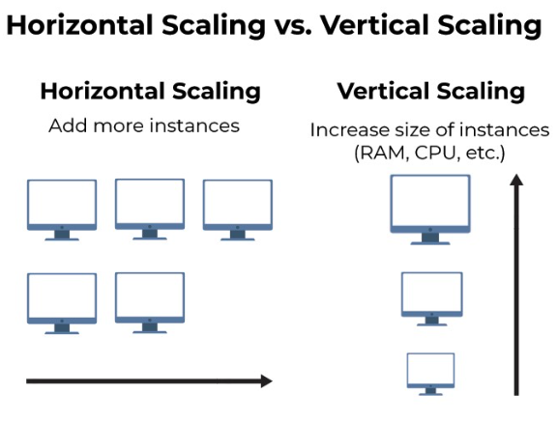
Resource management and dynamic application scaling
We distinguish two scaling modes: vertical and horizontal
Vertical scaling keeps the number of VMs of an application constant, but increases the amount of resources allocated to each one of them.
  This can be done either by migrating the VMs to more powerful servers or by keeping the VMs on the same servers but increasing their share of the CPU time.
  The first alternative involves additional overhead; the VM is stopped, a snapshot of it is taken, the file is transported to a more powerful server, and, finally, the VM is restated at the new site
Horizontal scaling is the most common mode of scaling on a cloud; it is done by increasing the number of VMs as the load increases and reducing the number of VMs when the load decreases.
  Often, this leads to an increase in communication bandwidth consumed by the application.
  Load balancing among the running VMs is critical to this mode of operation. For a very large application, multiple load balancers may need to cooperate with one another.
  In some instances the load balancing is done by a front-end server that distributes incoming requests of a transaction-oriented system to back-end servers.

Slide 34
Resource management and dynamic application scaling
An application should be designed to support scaling.
In the case of a modularly divisible application, the workload partitioning is static, it is decided a priori, and cannot be changed; thus, the only alternative is vertical scaling.
In the case of an arbitrarily divisible application the workload can be partitioned dynamically; as the load increases, the system can allocate additional VMs to process the additional workload.
Most cloud applications belong to this class, which justifies our statement that horizontal scaling is the most common scaling mode.

Slide 35
Resource management and dynamic application scaling
Mapping a computation means to assign suitable physical servers to the application.
A very important first step in application processing is to identify the type of application and map it accordingly.
Example, a communication-intensive application should be mapped to a powerful server to minimize the network traffic. This may increase the cost per unit of CPU usage, but it will decrease the computing time and probably reduce the overall cost for the user.
At the same time, it will reduce the network traffic, a highly desirable effect from the perspective of the cloud service provider
To scale up and down a compute-intensive application, a good strategy is to increase or decrease the number of VMs or instances.
Because the load is relatively stable, the overhead of starting up or terminating an instance does not increase significantly the computing time or the cost.

Slide 36
Resource management and dynamic application scaling
There are several strategies to support scaling.
Automatic VM scaling uses predefined metrics, e.g., CPU utilization, to make scaling decisions.
  Automatic scaling requires sensors to monitor the state of VMs and servers; controllers make decisions based on the information about the state of the cloud, often using a state machine model for decision making.
  Example: Amazon and Rightscale
Nonscalable or single-load balancers are also used for horizontal scaling.
  The Elastic Load Balancing service from Amazon automatically distributes incoming application traffic across multiple EC2 instances.
  Another service, the Elastic Beanstalk, allows dynamic scaling between a low and a high number of instances specified by the user.
  The cloud user usually has to pay for the more sophisticated scaling services such as Elastic Beanstalk.

